Slide 1
PROFESSIONAL ETHICS PRESENTATION
TOPIC:CHARACTER AND SPIRITUALITY
PRESENTED BY:
NAME : P.GURU VISHNU SAI
ROLL NO : 33
BRANCH : CSE (DS)

Slide 2
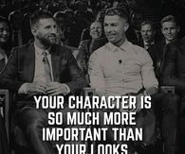
Character:
A characteristic property that defines the apparent individual nature of something
the inherent complex of attributes that determines a person's moral and ethical actions and reactions is known as character.

Slide 3
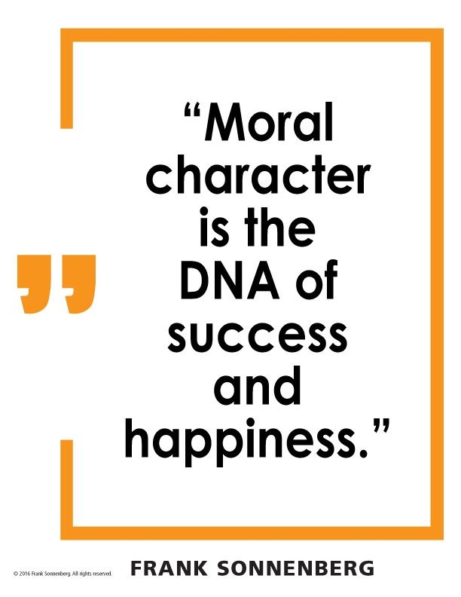
What is Character?
Originally from the Greek, kharakter, meaning a mark that could be distinguished from other marks, character in the context of real life refers to the sum of attributes or qualities that describe a person. For example, a person could be described as tall, sensitive, intelligent, and kind, and might be referred to as having "strong character." This term is also used to refer to roles that an actor plays or fictional people in a story or novel.

Slide 4
What is the characteristics of character?
Honesty trustworthiness fairness
Respect caring inspiring
Integrity confidence Courageous
Loyal unselfish citizenship
Tact competent

Slide 5
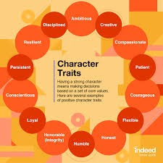
What are Character Traits?
Character traits are defined as the individual qualities or attributes that make up a person's overall character. These descriptions can be physical, emotional, mental, or moral. Every person is made up of many different traits or qualities, and these can also change over the course of someone's life. In literature, the traits of a character can change over the course of the plot.

Slide 6
Examples of best work character traits:
While there are many character traits that can contribute to career success, here are some of the top characteristics that can help you advance in the workplace:
1. Ambitious
An ambitious person is someone who has a strong desire to achieve success by meeting their goals. You might have demonstrated ambition when you applied hard work and dedication to overcome a challenge or exceed company objectives.
2. Creative
Someone who is creative can use their imagination to make or invent something. Creativity doesn’t only apply to artistic roles. It requires creativity to solve a difficult problem, present information in a clear, interesting way or find better ways to complete tasks.
3. Compassionate
A compassionate person is someone who can both feel and express sympathy for others. You might display compassion when you help a colleague overcome a difficult challenge. Compassion is a helpful trait in any position but could be especially helpful in customer service roles.

Slide 7
4. Courageous
A courageous employee is someone who is not deterred by challenges and difficulties. They’re likely to take on projects others fear may be too hard or require too much work. They might also take more calculated risks in the workplace, which can lead to gains for a company.
5. Flexible
Flexible people can quickly adapt to changes in plans, such as shortened project timelines or new client needs. The ability to modify your behaviors based on changes in the work environment is critical to succeeding in fast-paced roles and companies.
6. Honest
An honest person is always sincere and truthful and generally does not feel comfortable participating in deceptive practices. While honesty is essential in all positions, it’s especially important in heavily regulated industries such as healthcare and finance.

Slide 8
7. Humble
Humble people are able to exercise humility. They avoid boasting about their accomplishments and are respectful when earning praise or recognition. You may display this trait if you’re a leader who ensures your entire team is given credit for achieving a goal.
8. Honorable (Integrity)
Someone who is honorable has integrity and acts according to their principles and ethics. An honorable employee is someone who will ensure they always behave in ways that reflect positively on the company where they work.
9. Loyal
A loyal employee is supportive of an organization and its mission. Someone who is loyal can be trusted with sensitive information and is more likely to stay at a company long-term.
10. Patient
Patient people are able to tolerate setbacks, delays or unexpected challenges without becoming anxious or angry. Having patience is essential for jobs where it can take a long time to see the results of your efforts, such as when leading a marketing team or campaign.

Slide 9
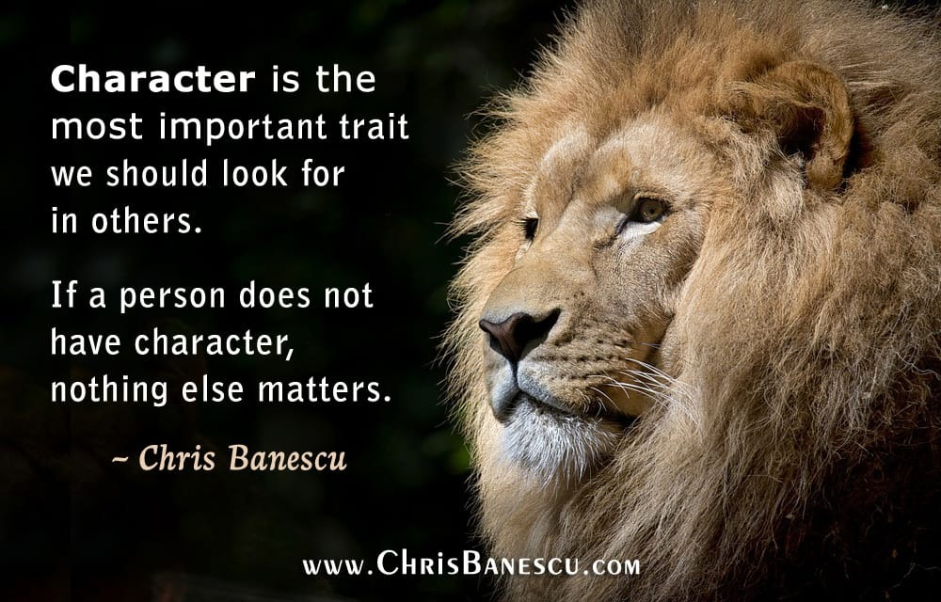

Slide 10
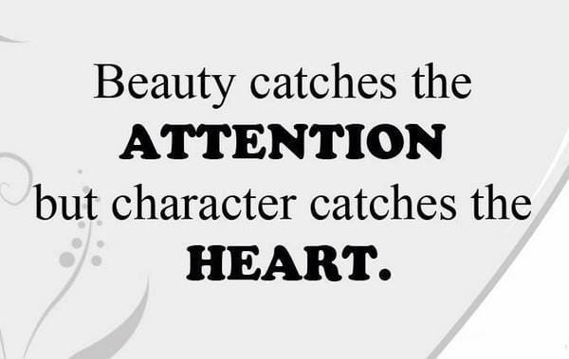

Slide 11
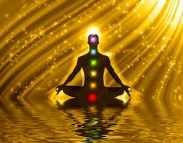
Spirituality:
What Is Spirituality?
Spirituality is the place within yourselves where your soul can find a sense of peace. It’s a concept completely liberated from any rules, institutions or hierarchy and it’s dedicated to the human soul.

Slide 12
Spirituality is a personal experience that creates a system of personal beliefs when searching for the meaning of life. It stands for something greater in life than the physical or material world.
Spirituality is also a way of dealing with everyday challenges in life and connecting with something bigger than yourselves.
Being spiritual can mean different things to different people.
For some, spirituality can be related to religion and even higher power. For others, it can be a non-religious experience such as connecting with nature, art, yoga, meditation, etc.

Slide 13
Types of Spirituality
Here are some of the most common ones:
#1. Mystical Spirituality
This type of spirituality is focused on the intuitional part of the soul. People who have mystical spirituality believe that there’s a greater unity to every experience in life.
Every experience goes beyond the material or physical world, and everything can be brought into one greater unity. For example, people with this type of spirituality may support the idea that everything happens for a reason. There’s a greater explanation behind everything and that would be what unites all the different experiences.

Slide 14
#2. Authoritarian Spirituality
This type of spirituality is believing in a hierarchical structure of things or in authority.
Often, this type of spirituality is associated with religious beliefs. There are cases when not following the spiritual rules of religion may cause conflicts.
People with authoritarian spirituality can develop a form of fundamentalist religion.
Fundamentalists believe that their religion is the most truthful one. They tend to exclude every other religion which, unfortunately, can be the cause for radical religious terrorism.

Slide 15
#3. Intellectual Spirituality
The core belief behind this type of spirituality is knowledge. Intellectually spiritual people are prone to gaining knowledge of spiritual theories and analyzing the information they get their hands on.
One form of this spiritual journey is studying theology, for example. However, this type of spirituality is not solely related to studying religion. Any knowledge that helps people improve their spirituality is a form of intellectual spirituality.

Slide 16
#4. Service Spirituality
This is one of the most common types of spirituality. It’s because people experience spiritual peace when they serve others.
There are many ways to achieve this spirituality, but the core of it is helping others without expecting nothing in return. Doing something that will benefit someone without getting something back is a common way for people to get in touch with their spiritual selves.

Slide 17
#5. Social Spirituality
Experiencing spiritual awakening when you are surrounded by other people explains this type of spirituality.
Being in religious groups is one way to experience this spirituality.
However, this can also be achieved with any other form of a group – exercising, nature-related activities, meditation, etc.
Since there are multiple types of spirituality, there are also various ways of spiritual practices too.

Slide 18
#5. Social Spirituality
Experiencing spiritual awakening when you are surrounded by other people explains this type of spirituality.
Being in religious groups is one way to experience this spirituality.
However, this can also be achieved with any other form of a group – exercising, nature-related activities, meditation, etc.
Since there are multiple types of spirituality, there are also various ways of spiritual practices too.

Slide 19

Ways of Spiritual Practices:
There are also 5 spiritual practices and with them, anyone can achieve a true spiritual self:
(1)Path of Knowledge
The main idea behind this practice is the power knowledge gives to people. This practice revolves around the idea that ultimate liberation can happen with acquiring knowledge.

Slide 20

(2)Path of Devotion
This spiritual practice has liberation from your ego as its core element. This is partly because many people who consider themselves religious will use some of these methods to express their spirituality.
However, it’s not always connected with religion. People also devote themselves to a higher power source or their consciousness to experience spiritual freedom.
Some of those methods are chanting, praying, mantras, and belief to become more spiritually aware.

Slide 21
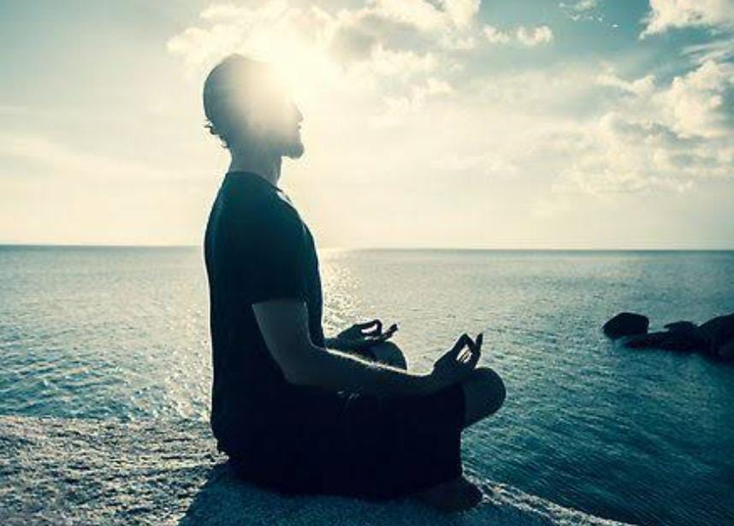
(3)Path of Meditation:
Meditation is one of the most common methods people are using to get better in touch with their true spirit. Alongside meditation are breathing techniques, asceticism, and teacher relationship.
The basis of this spiritual practice is calmness. People believe that whatever they accumulate through their life can be channeled through these methods. This way, dealing with everyday life challenges becomes easier because there’s a way to let go of all the negative thoughts.
Raja Yoga, Nada Yoga, and Buddhism are some examples of this spiritual practice.

Slide 22

(4)Path of Service:
Similar to the service type of spirituality, this spiritual practice is about active selflessness.
These people are liberated from any rules and rely only on giving rather than receiving.
For them, this is the only way to redeem themselves from any challenge or negative situation in life.
Volunteering, helping in Red Cross, helping those in need, working with people or children with disabilities – any type of selfless act falls under this category.

Slide 23
(5)Path of Energy:
More than a combination of different methods and core elements, this practice revolves around the idea of purification of your body and mind.
There are all kinds of methods, such as meditation, breathing, somatic techniques, and teacher relationship.
A person can achieve spiritual guidance in this practice in many ways. Some people use ritual behavior or activity to achieve this, others may concentrate solely on improving their physical health.
Whatever the action, the goal is to achieve purified both body and mind, liberated from the toxic elements you encounter in everyday lives.

